Slide 1
Collection

Slide 2
Methods OF Collection
5) Object set(int index,Object new);//to replace
6) Int indexOf(Object o);
Returns index of first occurrence of “o”.
7) Int lastIndexOf(Object o);
8) ListIterator listIterator();

Slide 3
ArrayList:
1) The underlying data structure is resizable array (or) growable array.
2) Duplicate objects are allowed.
3) Insertion order preserved.
4) Heterogeneous objects are allowed.
5) Null insertion is possible.

Slide 4
Constructor OF ArrayList
ArrayList a=new ArrayList();
Creates an empty ArrayList object with default initial capacity “10” if ArrayList reaches its max capacity then a new ArrayList object will be created with

Slide 5
ArrayList Capacity Increase

Slide 6
ArrayList
2.ArrayList a=new ArrayList(int initialcapacity);
• Creates an empty ArrayList object with the specified initial capacity
3. ArrayList a=new ArrayList(collection c);
Creates an equivalent ArrayList object for the given Collection that is this constructor meant for inter conversation between collection objects. That is to dance between collection objects.

Slide 7
Example OF ArrayList
ArrayList a=new ArrayList();
a.add("A");
a.add(10);
a.add("A");
a.add(null);
System.out.println(a);//[A, 10, A, null]
a.remove(2);
System.out.println(a);//[A, 10, null]
a.add(2,"m");
a.add("n");
System.out.println(a);//[A, 10, m, null, n]

Slide 8
ArrayList
Usually we can use collection to hold and transfer objects to provide support for this requirement every collection class implements Serializable and Cloneable interfaces.
• ArrayList and Vector classes implements RandomAccess interface so that any random
element we can access with the same speed.

Slide 9
ArrayList
RandomAccess interface present in util package and doesn’t contain any methods. It is a marker interface.

Slide 10
Differences between ArrayList and Vector?

Slide 11
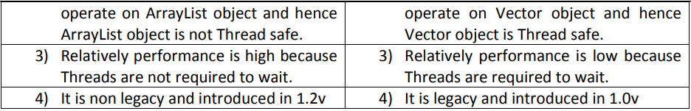
ArrayList VS Vector

Slide 12
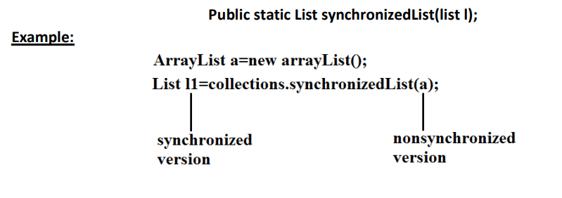
synchronized version of ArrayList

Slide 13
Similarly we can get synchronized version of Set and Map objects by using the following methods.
1) public static Set synchronizedSet(Set s);
2) public static Map synchronizedMap(Map m);

Slide 14
ArrayList
ArrayList is the best choice if our frequent operation is retrieval.
ArrayList is the worst choice if our frequent operation is insertion (or) deletion in the middle because it requires several internal shift operations.

Slide 15
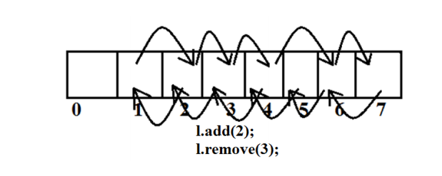
ArrayList Disadvantage

Slide 16
LinkedList:
1) The underlying data structure is double LinkedList
2) If our frequent operation is insertion (or) deletion in the middle then LinkedList is the best choice.
3) If our frequent operation is retrieval operation then LinkedList is worst choice.
4) Duplicate objects are allowed.
5) Insertion order is preserved.
6) Heterogeneous objects are allowed.
7) Null insertion is possible.

Slide 17
LinkedList
Implements Serializable and Cloneable interfaces but not RandomAccess.
Usually we can use LinkedList to implement Stacks and Queues to provide support for this requirement LinkedList class defines the following 6 specific methods.

Slide 18
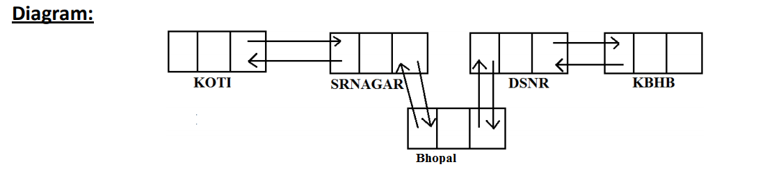
LinkedList

Slide 19
LinkedList 6 specific methods.
1) void addFirst(Object o);
2) void addLast(Object o);
3) Object getFirst();
4) Object getLast();
5) Object removeFirst();
6) Object removeLast();
We can apply these methods only on LinkedList object.

Slide 20
Constructors:
1) LinkedList l=new LinkedList();
• Creates an empty LinkedList object.
2) LinkedList l=new LinkedList(Collection c);
• To create an equivalent LinkedList object for the given collection.

Slide 21
Vector
1) The underlying data structure is resizable array (or) growable array.
2) Duplicate objects are allowed.
3) Insertion order is preserved.
4) Heterogeneous objects are allowed.

Slide 22
Vector
5) Null insertion is possible.
6) Implements Serializable, Cloneable and RandomAccess interfaces.
• Every method present in Vector is synchronized and hence Vector is Thread safe.

Slide 23
Vector specific methods:
To add objects:
1) add(Object o);-----Collection
2) add(int index,Object o);-----List
3) addElement(Object o);-----Vector

Slide 24
To remove elements:
1) remove(Object o);--------Collection
2) remove(int index);--------------List
3) removeElement(Object o);----Vector
4) removeElementAt(int index);-----Vector
5) removeAllElements();-----Vector
6) clear();-------Collection

Slide 25
To get objects:
1) Object get(int index);---------------List
2) Object elementAt(int index);-----Vector
3) Object firstElement();--------------Vector
4) Object lastElement();---------------Vector

Slide 26
Other methods:
1) Int size();//How many objects are added
2) Int capacity();//Total capacity
3) Enumeration elements();

Slide 27
Constructors:
1) Vector v=new Vector();
• Creates an empty Vector object with default initial capacity 10.
Once Vector reaches its maximum capacity then a new Vector object will be created with double capacity. That is “newcapacity=currentcapacity*2”.

Slide 28
Vector
2) Vector v=new Vector(int initialcapacity);
3) Vector v=new Vector(int initialcapacity, int incrementalcapacity);
4) Vector v=new Vector(Collection c);

Slide 29
Stack:
1) It is the child class of Vector.
2) Whenever last in first out order required then we should go for Stack.
Constructor:
• It contains only one constructor. Stack s= new Stack();

Slide 30
Methods:
Object push(Object o);
• To insert an object into the stack.
2) Object pop();
• To remove and return top of the stack.
3) Object peek();
• To return top of the stack without removal.
4) boolean empty();
• Returns true if Stack is empty.

Slide 31
Stack
5) Int search(Object o);
Returns offset if the element is available otherwise returns “-1”

